Slide 1
Stanford Big-Data Initiative in International Macro-Finance
Generative Artificial Intelligence and
Economic Applications
Susan Athey, Professor, Stanford GSB
Wednesday, August 2nd , 2023

Slide 2
Unsupervised ML
Clustering/segmentation X_{i}->G(X_{i})
Grouping photos or text
Supervised ML
Prediction/classification : predict E[Y|X=x] as f(X)
Computer vision/image recognition
Generative
Creating fake items (images, text): make fake X or fake X|prompt
Need a dataset of “real” items to mimic; need labelled for prompt
Predicting loan default
Synthetic datasets for analysis/testing of models
Adaptive experiments
Online learning to select the best ad, target ads to individuals
Bandits, contextual bandits: assign TREAT as func. of X to max Y
Reinforcement learning
Learning in a dynamic environment
Robot learns to climb a wall
Algorithm learns to play a video game
Identifying clusters of consumers according to behavior
Foundation Models
Use a large corpus of items (e.g. text) to train a model that creates representions of objects, typically a generative model
Used as input for downstream tasks; fine-tuned for an application

Slide 3
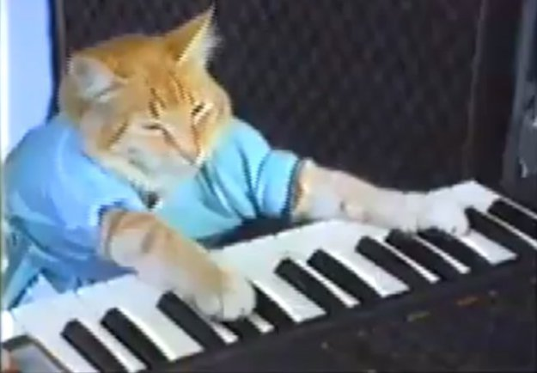
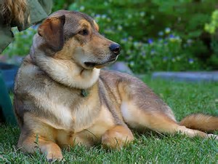
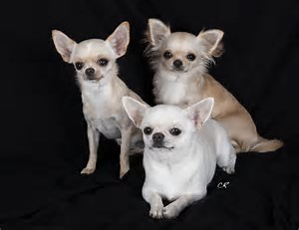
Machine Learning and AI
Advances in ML dramatically improve quality of image classification

Slide 4
Machine Learning and AI
X_{i}
Neural nets figure out what features of image are important
Features can be used to classify images
Relies on stability
$$\operatorname{Pr}\left(Y_{i}=CAT | X_{i}\right)=.95$$
$$\operatorname{Pr}\left(Y_{i}=DOG | X_{i}\right)=.05$$

Slide 5
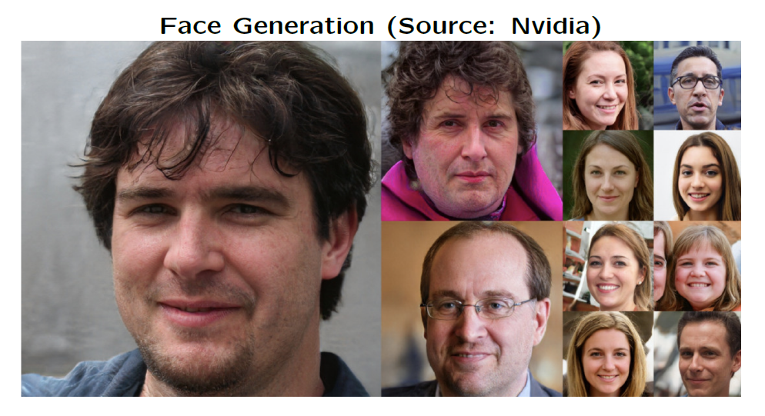
Generative AI
Generative Adversarial Networks (GANs)
Predicting a joint distribution harder than
E[Y|X=x]

Slide 6
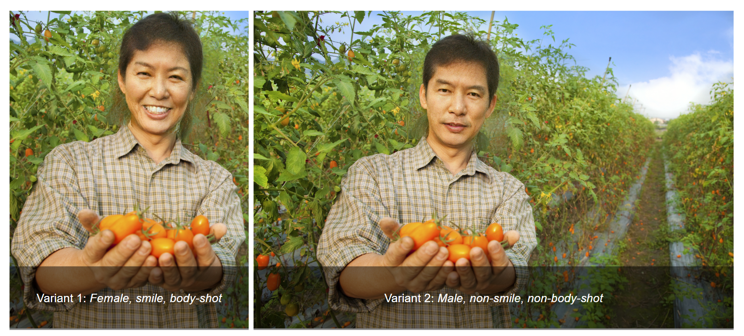
Generative AI for Research/Understanding: Athey et al learn how profiles affect ability to get loans on Kiva

Slide 7
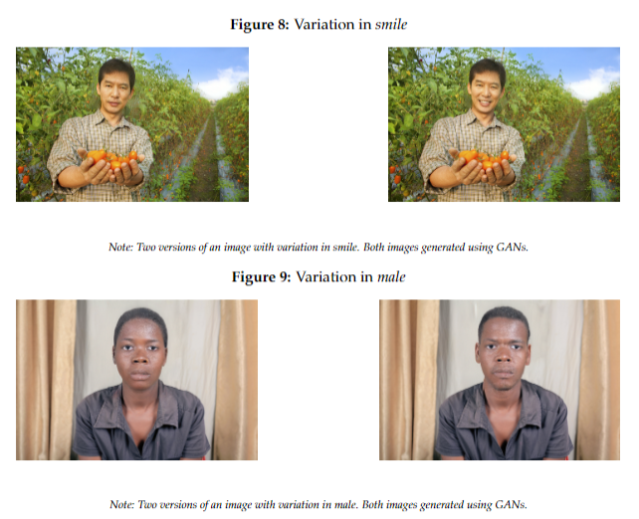
Using AI for Economic Research
Fairness/discrimination and the use of images:
Understanding image components: Athey et al 2022 (Kiva)
Extract image features, analyze their impact on getting funded, repayment
Distinguish between style (manipulable) and type (intrinsic)
Understand correlation among style and type features
Style (e.g. smiles) correlated with type (e.g. gender), and both correlated with lender choices
Experiment studying GAN-created images to isolate effect of style
Analyze efficiency-equity tradeoffs for counterfactual policies
Encourage everyone to smile? ☺
How do images affect human choice and outcomes?
How can we measure and manage efficiency-equity tradeoff?

Slide 8
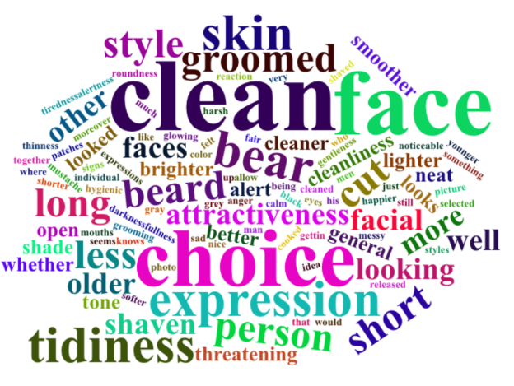
Generative AI for Research/Understanding: Ludwig et al understand what judges look for in mugshots
Learn judge preferences from past behavior

Slide 9
Generative Text: Basics
Generative language model: probability model that can be used to generate text.
Given text so far, what’s most likely to come next?
Next word | Probability
cat | 15%
bone | 8%
…
Total | 100%
The dog chased the…

Slide 10
Generative Text: Basics
Generative language model: probability model that can be used to generate text.
Given text so far, what’s most likely to come next?
Next word | Probability
cat | 15%
bone | 8%
…
Total | 100%
The dog chased the…

Slide 11
Generative Text: Basics
The
The
dog
The dog
chased
The dog chased
the
The dog chased the
cat
The dog chased the cat
<END>

Slide 12
How is ChatGPT different from simple probability-based model?
If we treat each word and phrase as unique, too many combos
Thousands of commonly used words
Unwieldy number of unique phrases
“Representations” or “embeddings”
Words, phrases, sentences, paragraphs “represented” by list of numbers
Two phrases that are “similar” both map onto similar list of numbers
A more “complex” embedding has a longer list of numbers
Transformer models
A particular way to construct the representations
Encodes phrases, and also encodes how much “attention” to pay to surrounding words in order to understand this particular phrase
Final encoding builds up from the phrase & surrounding words
Scaling explodes with amount of text—pairs of words, triples, etc.
No secret sauce! 1000s researchers train, w/ less data, compute.
ChatGPT has 1 trillion parameters
ChatGPT 2 had billions, much much worse
Learning parameters vs. predicting: predicting is cheap
If I knew the parameters, I could reproduce ChatGPT’s output with relatively inexpensive compute
Facebook LLaMa was leaked, performance between ChatGPT 3 and 4

Slide 13
Architecture of an App that Builds on Azure OpenAI API
Fine Tuning
Start with the parameters from LLM
Update them to fit custom dataset
Much cheaper than general training
Can use internal company docs or custom public data
Privacy & IP: an intermediary protects user data & foundational LLM model from one another
Data Privacy – Azure documentation
Your prompts (inputs) and completions (outputs), your embeddings, and your training data:
are NOT available to other customers.
are NOT available to OpenAI.
are NOT used to improve OpenAI models.
are NOT used to improve any Microsoft or 3rd party products or services.
are NOT used for automatically improving Azure OpenAI models for your use in your resource
Your fine-tuned Azure OpenAI models are available exclusively for your use.
Microsoft hosts the OpenAI models in Microsoft’s Azure environment and the Service does NOT interact with any services operated by OpenAI (e.g. ChatGPT, or the OpenAI API)
User Experience
App
Prompt Augmentation
Response Transformation & Filtering
Fine-Tuned LLM
Azure
Custom App Data
Foundation Model
App provides;
Not shared (?)
Public Data
OpenAI

Slide 14
How does ChatGPT and APIs use LLM
API calls have limited parameters, and then just text.
https://YOUR_RESOURCE_NAME.openai.azure.com/openai/deployments/YOUR_DEPLOYMENT_NAME/chat/completions?api-version=2023-05-15 \
-H "Content-Type: application/json" \
-H "api-key: YOUR_API_KEY" \
-d '{"messages":[
{"role": "system", "content": "You are a helpful assistant."},
{"role": "user", "content": "Does Azure OpenAI support customer managed keys?"},
{"role": "assistant", "content": "Yes, customer managed keys are supported by Azure OpenAI."},
{"role": "user", "content": "Do other Azure Cognitive Services support this too?"}]}'

Slide 15
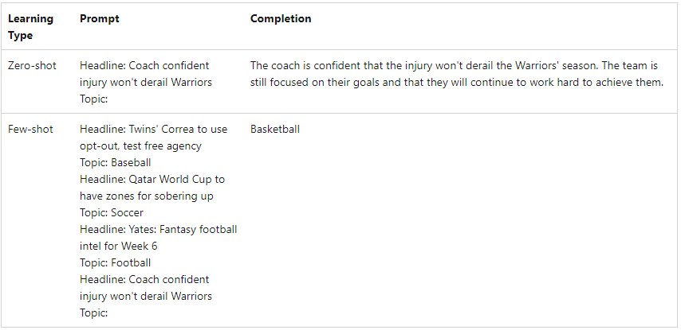
How does ChatGPT and APIs use LLM
Pricing ballpark (note: service has real compute costs)
GPT-3.5: $30 per million words
GPT-4: $100 per million words
Today, everything is just prediction of next word
Services built on top of ChatGPT turn the desired outcome into a “prompt” with only a few cues
ChatGPT predicts likely words that come next

Slide 16
How does ChatGPT and APIs use LLM

Slide 17
Foundation Models in Economics
Specific types of text
Reviews (e.g. Archak et al, 2011, Gentzkow et al 2019)
Political text (Gentzkow et al, 2019)
Health notes (Zeng, Gensheimer, Rubin, Athey, & Shachter, 2022).
Representations of products & consumer behavior
Ruiz, Athey & Blei (2019); Athey, Blei, Donnelly, & Ruiz (2022)
Labor economics
Job listings & skills: Bana (2022)
Job transitions: Vafa, Athey & Blei (2022, 2023)
Can be released to researchers
Enables sharing data without violating privacy (more work to do!)
Fine-tuning on smaller, representative datasets
Federated learning may also be possible
Opportunities and Initial Progress

Slide 18
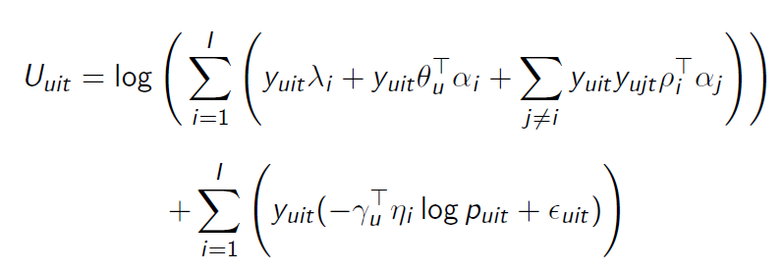
Representations of Products: Substitutes and Complements
Ruiz, Athey and Blei, AOAS, 2019:
Model of boundedly rational consumer choice over shopping baskets with 1000s of products
Estimates preference parameters (substitutes and complements) from data that includes thousands of price changes
Factorization to reduce the dimensionality of interaction effects
Heuristic model of sequential decision-making, generating artificial shopping carts
Ignoring all textual information and product hierarchy, we infer complementary products from observed choices

Slide 19
Decomposing Changes in the Gender Wage Gap over Worker Careers
Keyon Vafa
Harvard University
(incoming postdoctoral fellow)
Susan Athey
Stanford University
Graduate School of Business
David Blei
Columbia University
Dept. of Computer Science

Slide 20
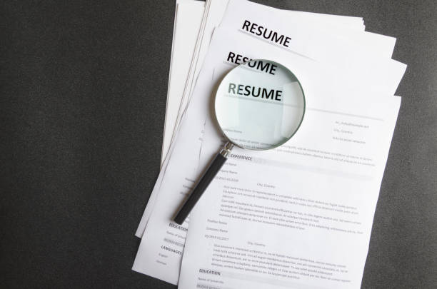
Representing histories with transformers
Transformers require large amounts of data to learn high-quality representations.
Kaplan et al. (2020)
But longitudinal surveys collected in the U.S. are small.
CAREER is first trained to a dataset of 23.7M resumes to learn representations:
2002
2003
2023
2002
2003
2023
2002
2003
…
2023
Banker
2002
Banker
2003
…
Manager
2023
Banker
Banker
…
Manager
Banker
Banker
…
Manager
Banker
Banker
Manager
These representations are then adjusted to predict wage.
Notes:
Transformers learn representations by fitting an objective function to data. But they require large amounts of data to learn high-quality representations.
Meanwhile, wage gaps are estimated using longitudinal surveys, but longitudinal surveys are small.
So CAREER uses a large dataset of resumes alongside these surveys to learn representations, which are then adjusted to predict wage on surveys like PSID.

Slide 21
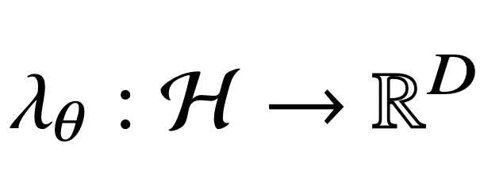
Modeling histories with machine learning
We develop machine learning methods to include occupational histories in GWG decompositions by learning low-dimensional representations of history
History h
Representation λ_{θ}(h)
2002
2003
2023
Banker
Banker
…
Manager
3.4, -1.1, -3.5, 2.4, …, 0.1
We analyze a dataset of 24M resumes to help learn these representations.
On PSID, our out-of-sample wage R² improves from 0.46 to 0.53, when additionally conditioning on representations of history.
Representations of history explain ~25% of GWG that is unexplained with standard covariates.
Notes:
In the first portion, we'll focus on the methodological challenge of using histories to decompose wage gaps: histories are high-dimensional -- there are many more possible sequences of jobs than there are individuals in survey datasets like the PSID that are used to estimate wage gaps. We sidestep this statistical estimation issue by developing machine learning solutions to summarize histories with low-dimensional vectors, which we call representations. Specifically, we learn a function that maps job histories to vectors in Euclidean space, and use these lower-dimensional representations to model wages instead of full histories. We use a large dataset of resumes to help learn these representations, and then show that including representations of histories improves predictive performance of wage on PSID. Moreover, representations of history explain ~25% of the gender wage gap that is unexplained by standard covariates.

Slide 22
Fitting CAREER's representation
Input
Goal
Passively-collected resumes
Representation that predicts next job
CAREER
pretraining on large-scale resumes:
2002
2003
2022
Banker
Banker
…
Manager
Manager
Survey data
Predict wage
CAREER
fine-tuning on longitudinal surveys:
2002
2003
2023
Tutor
Graduate student
…
Teacher
$24/hour
+ covariates and gender
Notes:
So at a high level, training CAREER's representation has two steps. In the first step, we learn representations from resumes by training a representation to predict which job comes next in a worker's career. This step is called pretraining. In the second step, this representation is adjusted on small surveys like PSID; the representations are adjusted so they're predictive of wage rather than next job.

Slide 23
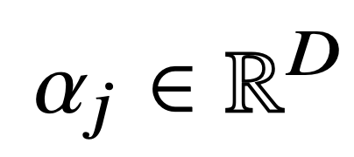
Pretraining: Representations for next-job
Resumes do not contain wages, but they contain many career trajectories.
Sequence from resume
Modeling objectives
p(H₁ = Banker)
2002
2003
2023
H =
…
p(H₂ = Analyst | H₁ = Banker)
Banker
Analyst
Manager
…
p(H₂₁ = Manager | h₁, ..., h₂₀ )
Model uses representations ( )
Representation is fit using resume sequences, where it acquires features that are also predictive of wage.
Notes:
Getting into the specifics, while resumes don't contain wages, they contain valuable information in the form of many career trajectories, so a representation trained to model which kinds of jobs co-occur in a career can learn valuable features about worker trajectories. We first train representations to predict which occupations come next in an individual's career using resumes. The functional form of these predictions involves incorporating representations into a multinomial logistic regression to predict an individual's next job. When the representation is fit to predict next jobs from resumes, it acquires features that are also predictive of wage.

Slide 24
Understanding representations
The representation is built iteratively. At first, each job has own representation:
Cashier
Then, representations are combined:
Tutor
Teacher
is a function of previous representations:
It weights representations by how informative they are for predicting teacher wage (attention). This process is repeated iteratively.

Slide 25
CAREER’s Computational Graph
CAREER builds a representation using a stack of L layers, starting with simple representation at layer 1 and growing in complexity.
{
…
Career history
…
…
…
…
…
…
…
…
{
Current job + covariates
…
{
{
{
{
Next job
Attention
Feed-forward neural net
Repeat for L layers
Two-stage prediction

Slide 26
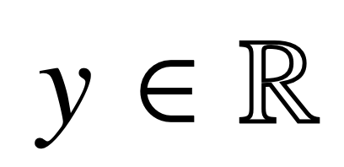
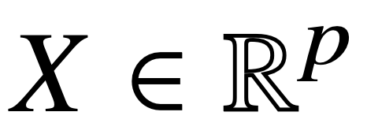
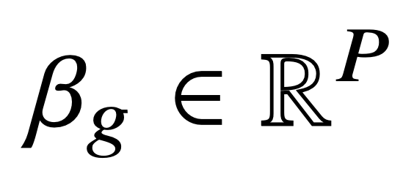
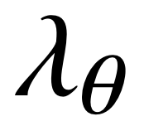
Fine-tuning: Representations for wage
On survey data, we adjust the representation to predict wages:
Survey observables
Modeling objective
2002
2003
2023
H =
…
Banker
Analyst
Manager
Log-wage , covariates , gender
Approximate conditional expected wage function with
is small neural network, is regression coefficients.
Optimize parameters to predict wage, initializing with fit to resumes.
Notes:
These representations are then adjusted on survey data so they are predictive of wage. Here, the goal isn't to model an individual's next job; instead, it's to model wage given gender, covariates, and history. We approximate the conditional expected wage function by using representations instead of full histories. We optimize all parameters to predict wage using gradient descent, and the representation parameters are initialized from the parameters pretrained to model next jobs on resumes. This pretraining gives it a head start.

Slide 27
Minimizing Omitted Variable Bias
We've described a method to learn representations that are predictive of wage.
But representations discard information. What if representations discard important aspect of history for explaining wage gap? (OVB)
We provide a condition under which representations do not omit important variables, which is satisfied when representations are sufficient:
gender
history
representation
standard covariates
We propose an inference algorithm to encourage representations that are both sufficient and predictive of wage.
Notes:
We've described a method to learn representations that are predictive of wage. But representations by definition discard information. So we're not actually decomposing wage gaps for full histories; we're decomposing them for representations of history. What if representations discard important aspects of history for explaining the wage gap? [read slide]
[before last bullet]
So, we would like representations to not only be predictive of wage, to sidestep the statistical estimation issue, but to also be sufficient, so they are valid for wage gap decompositions.
[last bullet]

Slide 28
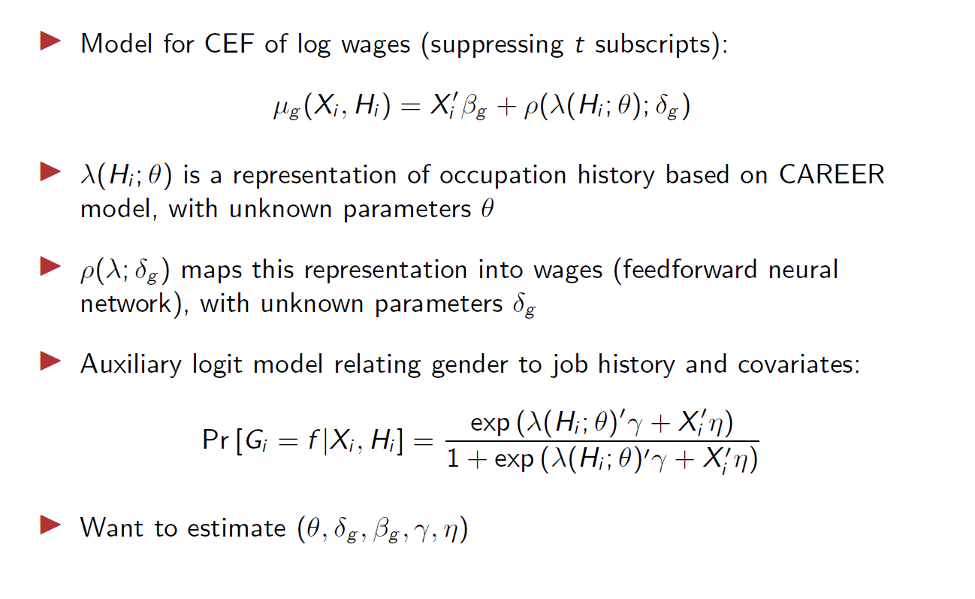
Fine-Tuning a Transformer Model

Slide 29
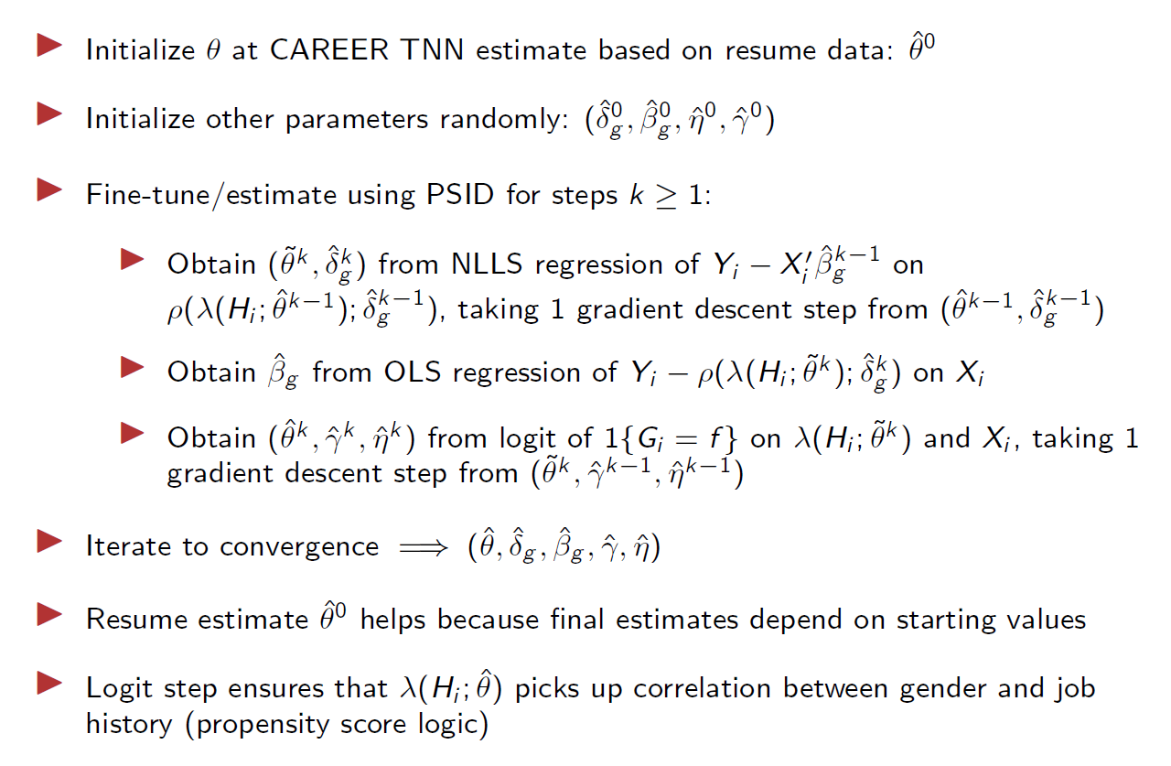
Fine-Tuning a Transformer Model

Slide 30
Which histories are improving predictions?
Clustering representations allows us to interpret the aspects of history that improve wage predictions.
These clusters (omitted by standard models) are also predictive of gender:
Coarse-grained current job:
Manager
Office / Admin Support
Sales
software developer,
electrical engineer
appliance repairer, electrical equip. repairer
cashier, homemaker
child care worker,
bank teller
child care worker,
homemaker
Subdivisions based on representations of history:
11% F
8% F
93% F
93% F
82% F
cook, housekeeper
truck driver, machine operator
44% F
7% F
Notes:
Clustering representations allows us to interpret the aspects of history that improve wage predictions.
These groupings (omitted by standard models) are predictive of both wage and gender:
we find that the job manager has many distinct types, that are captured by our representations.
we find that one subtype is managers that used to be engineers, a primary male group
we find that another subtype is managers that used to be cashiers and homemakers, a primary female group
adding these histories to baseline models improves their predictive performance.
[optional] not including histories is a type of omitted variable bias. our representations capture these variables that are usually omitted.

Slide 31
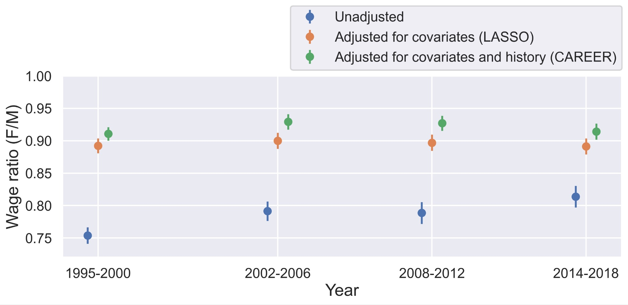
Decomposing wage gap
Unexplained wage ratio:
CAREER's representation of history explains ~25% of remaining wage gap when representation of history is not included between 1995-2018.
Notes:
Here we plot the unexplained wage ratio. In blue is the raw, unadjusted ratio. In orange is the unexplained wage ratio for summary statistics using the LASSO model. In green is the unexplained wage ratio using CAREER to adjust for both summary statistics and history. CAREER's representation of history explains ~25% of the remaining wage gap compared to when history is not included between 1995-2018.

